Slide 1

COMM223 Marketing Management
Lecture 4 - Consumer and Business Buyer Behavior

Slide 2
Agenda
Consumer buyer behavior
Buyer behavior model
Factors influencing consumer behavior
Buyer decision process
Buying decision on new product
Business buyer behavior
Business market
Business buyer behavior

Slide 3
Where are we now …
Company
Company Analysis
Competitor Analysis
Consumer Analysis
Marketing Management
Competitor
Consumer
Product
Promotion
Price
Distribution
Product - Market

Slide 4

Why Study Consumer Behaviour?
Consumer buying behaviour:
Buying behaviour of final consumers
Purchase goods and services for personal consumption
Consumer market:
All individuals and households
Buy or acquire goods and services for consumption
Canada: 37 million
Why are marketers interested in this?
Need to be able to understand consumer behaviour before we can (hope) to influence it

Slide 5
In other words….
If you don’t understand
WHY
someone might want your product
you can’t accurately
POSITION
it or develop a unique
MARKETING MIX
that helps convince them to
BUY IT!!

Slide 6
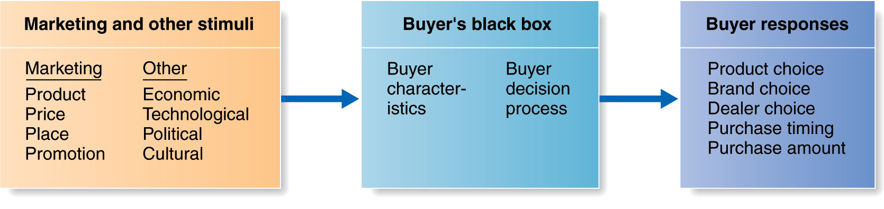
Model of Buyer Behavior
Buyer behaviour model:
Consumers are exposed to many stimuli including the marketing mix and other external factors
Buyer characteristics influence how these stimuli are perceived and processed
Buyer decision process results in behavior

Slide 7
Factors Influencing Consumer Behavior

Slide 8
Factors Influencing Consumer Behavior Cultural
Culture:
Set of basic values, perceptions, wants and behaviors
Learned from family and important institutions
Core values remain stable, while secondary values change slowly
Differences between cultures are important to international trade
Cultural shifts
Subculture:
A group of people with shared value systems
Based on common life experiences and situations

Slide 9
Factors Influencing Consumer Behavior Cultural
Social classes:
Relatively permanent and ordered divisions in a society
Whose members share similar values, interests, and behaviors
Measured by a combination of income, occupation, education, wealth, and other variables
Marketers are interested because consumption behavior tends to be consistent within a given social class

Slide 10
Factors Influencing Consumer Behavior Social
Groups:
Consumers belong to membership groups
Compare themselves to reference groups
May aspire to becoming a member of a group
Group influence varies across products and brands; strongest when the product is visible to (respected) others; symbolic nature
Opinion leader:
Person within a reference group
Skills, knowledge, personality
Who has exerts influence on others

Slide 11
Factors Influencing Consumer Behavior Social
Word-of-mouth influence
More creditable than commercial sources
Influencer marketing
Online social networks
Blogs, online social media, brand communities, and other online forums

Slide 12
Factors Influencing Consumer Behavior Social
Family:
First and strongest influence on behavior
Roles and influences within the family have been extensively researched
Past assumptions about gender influence are less valid today
Children learn consumption behavior early on

Slide 13
Social Factors
Social Influences: Family
Initiators
Influencers
Decision Makers
Purchasers
Consumers
Purchase Roles in the Family
Children
Influence
Purchase
Decisions

Slide 14
Factors Influencing Consumer Behavior Social
Roles and status:
Consumers play many roles, each requiring some type of consumption behavior
Products can be used to show status

Slide 15
Factors Influencing Consumer Behavior Personal
Age and Lifecycle stage
Occupation
Economic situation
Lifestyle
Personality and Self-concept

Slide 16
Factors Influencing Consumer Behavior Personal
Personal factors:
Consumer needs change over their lifetimes in (somewhat) predictable ways
Family life cycle: combines age with marital status and presence of children to classify consumers into groups
LIFE-CYCLE STAGES:
Young
Single with children
Married without children
Married with children
Divorced with children
Middle-aged
Single
Same-sex couples
Married without children
Married with children
Divorced without children
Divorced with children
Older
Older married
Older unmarried
Older with children again

Slide 17
Factors Influencing Consumer Behavior Personal
Occupation:
The type of work performed may necessitate different consumption patterns, such as blue collar versus white collar
Will also indirectly affect how much income is available
Economic situation:
How much income (or ability to borrow) is available for consumption
Economic indicators such as employment, inflation, interest rates, and consumer debt levels are used to predict changes in buying power

Slide 18
Factors Influencing Consumer Behavior Personal
Lifestyle:
A person’s pattern of living as expressed by their activities, interests, and opinions (AIO’s)
Lifestyle segmentation
Personality:
Unique psychological characteristics leading to relatively consistent and lasting responses to one’s own environment
Traits (e.g., self-confidence, autonomy, aggressiveness, sociability)
Useful for analyzing product and brand choices

Slide 19
Factors Influencing Consumer Behavior Psychological
Motivation
Psychological Influences on Buying Decisions
Perception
Learning
Beliefs & Attitudes

Slide 20
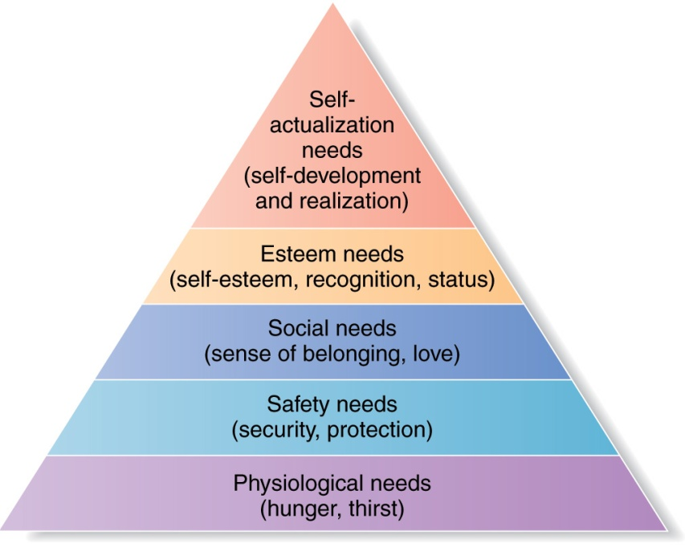
Factors Influencing Consumer Behavior Psychological
Motivation:
Humans are characterized by goal-directed behavior
Different needs/wants produce different behavior
A need that is sufficiently pressing to direct the person to seek satisfaction
Freud’s work focused on hidden and unconscious urges directing our behavior
Maslow’s hierarchy of needs focuses on how needs can be classified and ordered in terms of importance
Individuals are motivated to satisfy needs at a particular level before moving on

Slide 21
Factors Influencing Consumer Behavior Psychological
Perception:
The process by which people select, organize, and interpret information
To form a meaningful picture of the world
Selective Attention
Consumer screens out most of the information to which they are exposed
Selective Distortion
Consumer interprets information in a way that will support what they already believe
Selective Retention
Consumer retains the information that supports personal attitudes and beliefs

Slide 22
Factors Influencing Consumer Behavior Psychological
Learning:
Changes in an individual’s behavior arising from experience
Most learning occurs through drives, stimuli, cues, responses, and reinforcement
Consumers learn what satisfies their needs and what does not

Slide 23
Factors Influencing Consumer Behavior Psychological
Beliefs:
A descriptive thought about something
Attitudes:
A person’s consistently favourable or unfavourable evaluations, feelings, and tendencies towards something
They are difficult to change

Slide 24
Buyer decision process

Slide 25
The Buyer Decision Process
Need recognition:
Triggered by internal or external stimuli
Must reach an intensity high enough to become a drive
Needs are basic, wants are learned behavior to satisfy them

Slide 26
The Buyer Decision Process
Information search:
Influenced by level of involvement (interest) in the decision
Memory (internal) search
External search: personal, commercial, public, experiential sources of information
Word-of-mouth sources are most influential (credibility)
Need Less Information
Need More Information
Less risk
More knowledge
More product experience
Low level of interest
More risk
Less knowledge
Less product experience
High level of interest

Slide 27
The Buyer Decision Process
Evaluation of alternatives:
Evaluation procedure depends on the consumer and the buying situation
Attributes and importance weights are chosen as criteria
Alternatives compared against the criteria
Marketers can influence this stage; personal selling

Slide 28
The Buyer Decision Process
Purchase decision:
Two factors intercede between purchase intentions and the actual decision:
Attitudes of others
Unexpected situational factors

Slide 29
The Buyer Decision Process
Postpurchase behaviour:
What the consumer thinks and does after purchasing and using the product or service
Relationship between consumer expectation and perceived performance
Cognitive dissonance:
Buyer discomfort caused by postpurchase conflict
Customers want to believe that they make good decisions; will look for proof and discount information to the contrary
A good reason for customer follow-up programs

Slide 30
Positive Word-of-Mouth
Satisfaction
Repeat Purchase
Prior Expectation
Actual Performance
Negative Word-of-Mouth
Dissatisfaction
Complaint
Stop buying

Slide 31
Buyer Decision Process for New Products
New Products
Good, service or idea that is perceived by customers as new.
The Adoption Process
Mental process through which an individual passes from first hearing about an innovation to final adoption.
Five Stages in the Adoption Process
Awareness, interest, evaluation, trial, and adoption.

Slide 32
Buyer Decision Process for New Products Consumer factors
Individual Differences in Innovativeness
Consumers can be classified into five adopter categories, each of which behaves differently toward new products.

Slide 33
Buyer Decision Process for New Products Product factors
Influence of Product Characteristics on Rate of Adoption
Relative Advantage
Compatibility
Complexity
Divisibility
Communicability

Slide 34
Business Market
More dollars and items than consumer market
Market structure and demand
Far fewer but far larger than consumer market
Derived demand: ultimately comes from the demand for consumer goods

Slide 35
Business Market
Nature of buying unit
More decision participants and a more professional purchasing effort
Types of decisions and the decision process
More complex
Longer
More formalized
More dependent

Slide 36
Business Buyer Behavior
Major types of buying situations
Straight rebuy
Modified rebuy
New task
Systems selling (solutions selling)

Slide 37
Business Buyer Behavior
Major influences on business buyers

Slide 38
Business Buyer Behavior
Business buying process

Slide 39
Read chapter 6

